Slide 1
Maker’s university – by intel’s makers community class 5 – IOT & Remote access
Gil Tal.
Jul 2021

Slide 3
Class 5 agenda:
IOT
Control and communication over the air
  Wi-Fi
  Bluetooth
  LoRa
Wi-Fi basics
Webserver
Multicast DNS (mDNS)

Slide 4
Class 6 agenda:
ESP-Now protocol
Useful web services and protocols
Bluetooth
OTA (Over The Air update)
LoRa

Slide 5
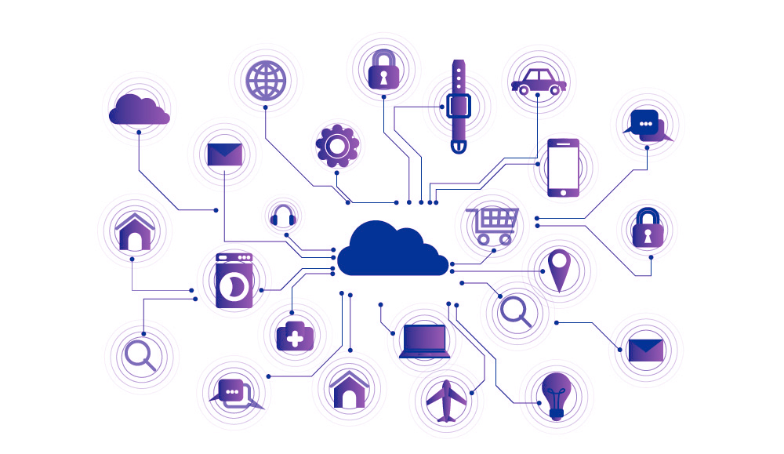
IOT
The Internet of things (IoT) describes the network of physical objects - a.k.a. "things“ - that are embedded with sensors, software, and other technologies for the purpose of connecting and exchanging data with other devices and systems over the Internet
Used for:
  Smart Homes
  Elder care
  Agriculture
  Environmental monitoring
  And more ….

Slide 6
Wi-fi basics
Wi-Fi basics:
  Family of wireless networking technologies
  IEEE 802.11 family of standards
  Used for local area networking of devices and Internet access
  20-150 meters range
  Standard defines 16 channels for communication
    Enables multiple access points at the same physical location

Slide 7
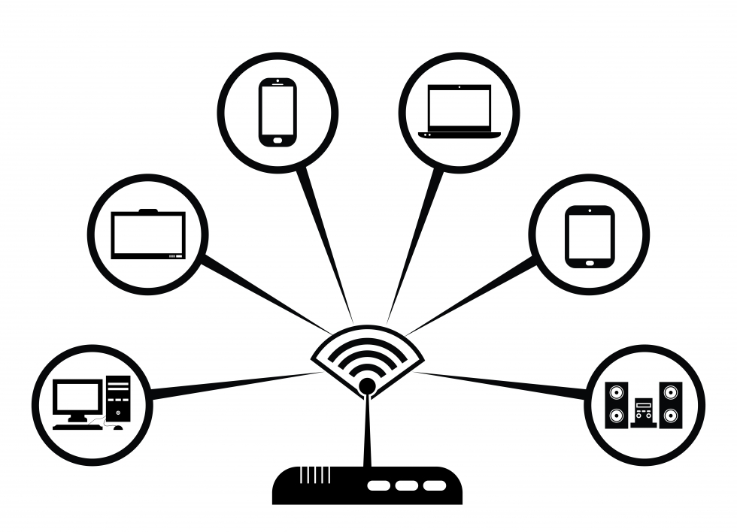
Wi-fi basics: AP and sta
End Point device
AP – Access point
  Enable the creation of a local Wi-Fi network
  We connect to an access point
  With or without access to the internet
  Uses a specific channel which can be modified while operating
  Has limitation for number of connected devices
  Has a name and an optional password
  Can use an encrypted communication protocol
STA – Station
  An end point device
  Connects to an AP
  While searching for an AP needs to scan different channels until found
  Station name and password can be saved on EEPROM, SPIFFS or SDCARD
AP

Slide 8
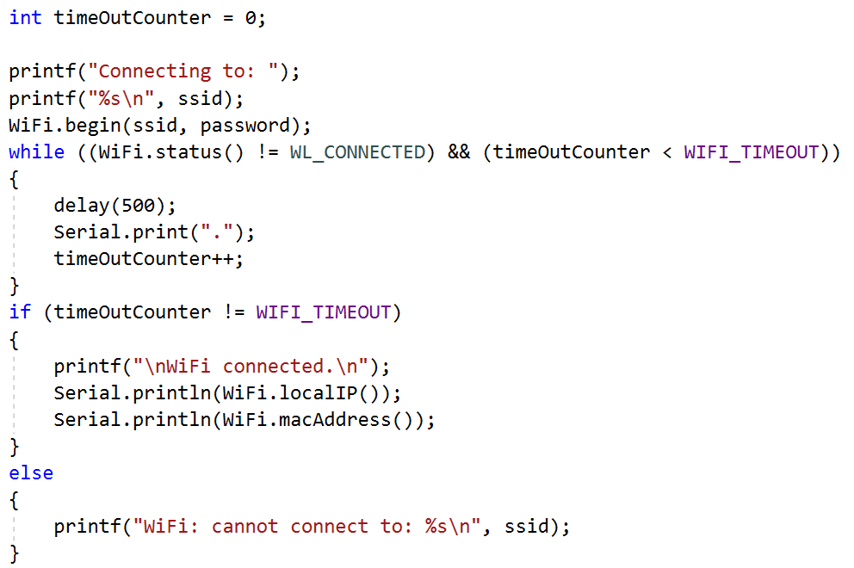
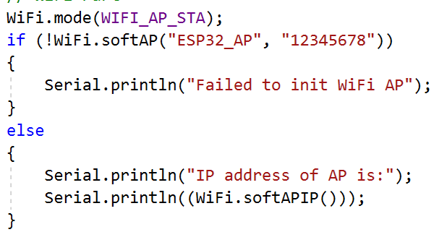
Wi-fi basics: our esp32
Runs full network stack
Can function as:
  AP
    By default enables up to 4 users
  STA
  Both*

Slide 9
HTML
Hyper Text Markup Language
  Is the standard markup language for documents designed to be displayed in a web browser
  It can be assisted by technologies such as Cascading Style Sheets (CSS) and scripting languages such as JavaScript
  https://www.w3schools.com/ - great site for learning and designing web pages

Slide 10
webserver
Web pages are hosted on a webserver
  Most commonly written in HTML5 + JAVA script
  There are various HTML5 emulators out there
Has a specific IP address (192.168.14.1 for example)
Is a passive device
We need a browser to access it
  Browser is executing the HTML5 code
  The communication protocol is HTTP
There are large number of hosting providers
IP address can be replaced by a name
  DNS server translates the name to the specific IP address
ESP32 can run a webserver! ☺

Slide 11
Webserver – what can we do with it
Have a nice GUI to communicate with the ESP32 using a browser
Control IOs
Get information from our ESP32
  Such as temperature, humidity depending on what we connected
Send data to the ESP32
  Files
  Raw data

Slide 12
Webserver – work flow
We need to initialize:
  WiFi
  Webserver
Prepare the HTML for the pages
Handle the client which interacts with the browser
Process the incoming data from the browser to perform actions on the ESP

Slide 13
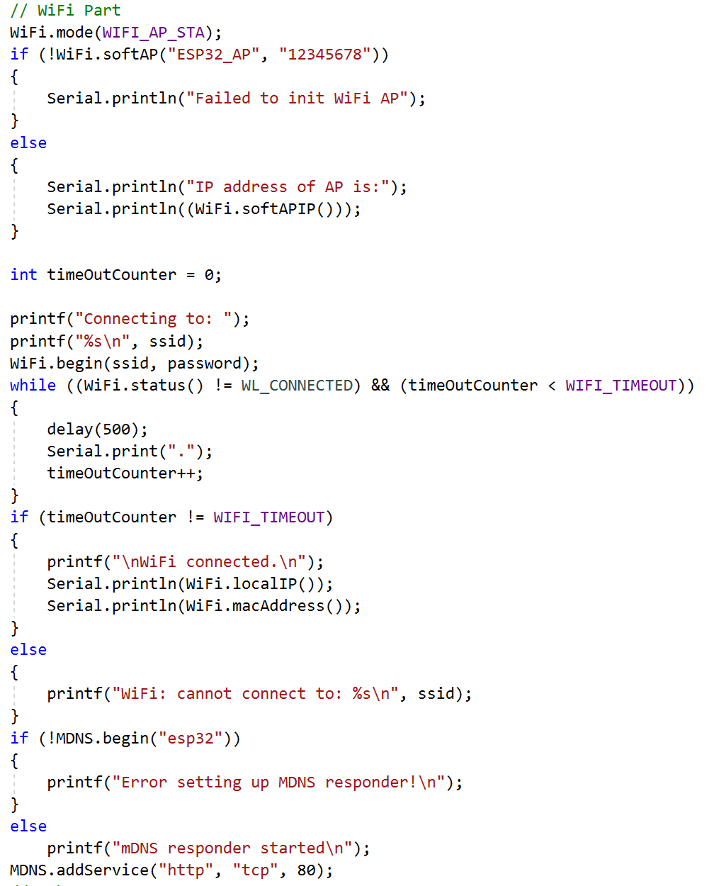
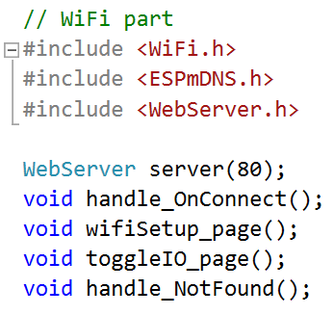
Webserver – Init code

Slide 14
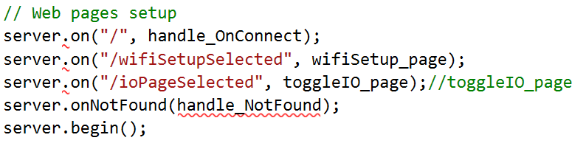
Webserver – INIT code

Slide 15
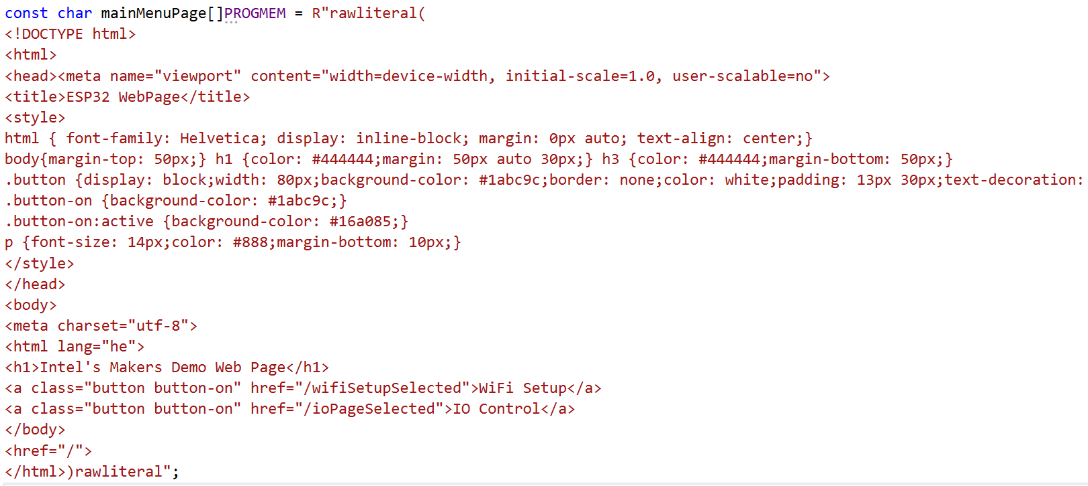
Webserver – html data

Slide 16
Webserver – html data
For static data with pre-defined start conditions:
const char mainMenuPage[]PROGMEM = R"rawliteral(
  HTML Data
)rawliteral";
For dynamic data with interactive page with need to use String and build the page in real time!

Slide 17
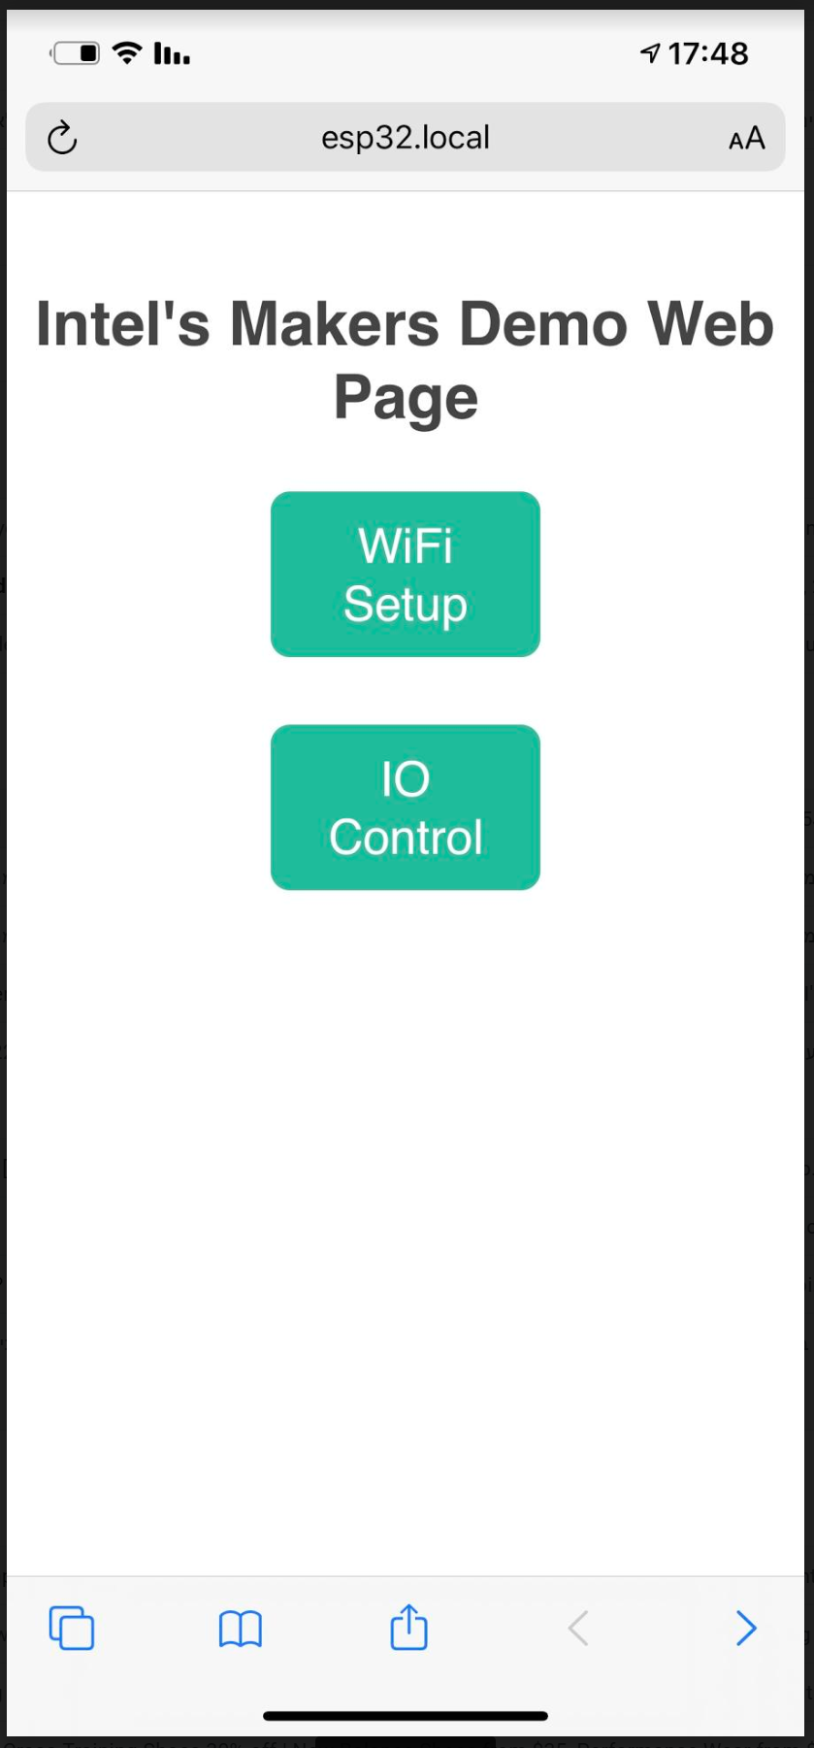
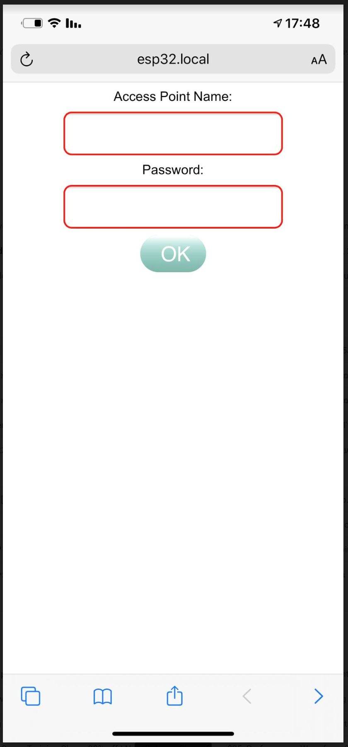
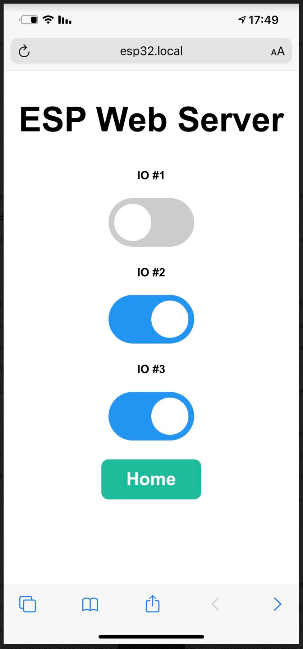
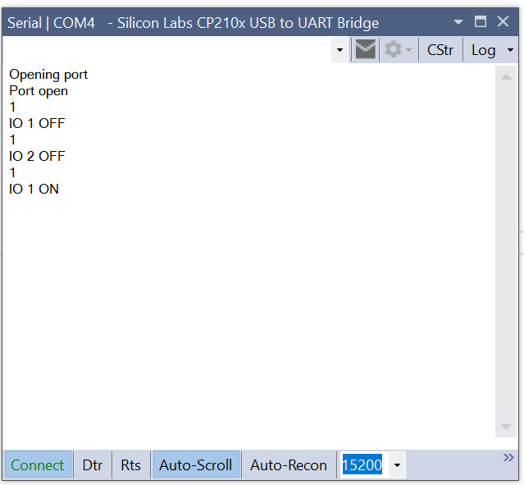
How does it looks…

Slide 18

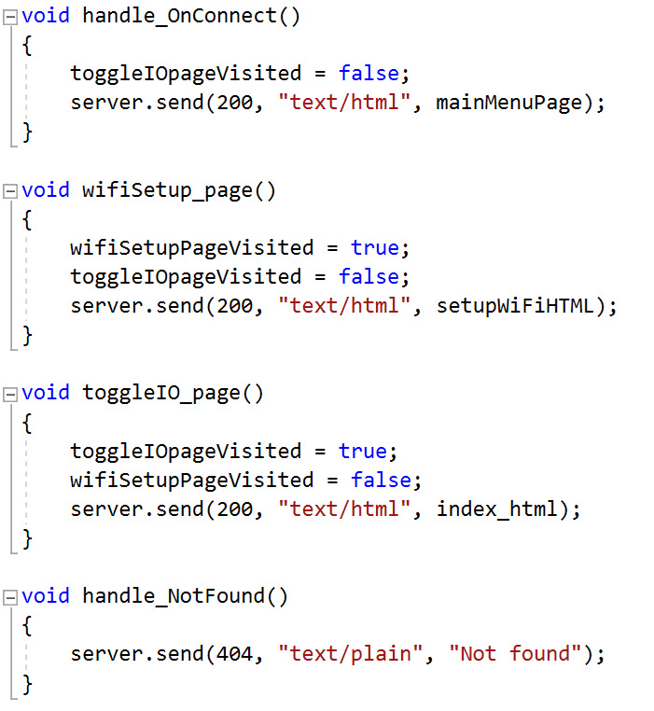
Webserver – handle the client

Slide 19
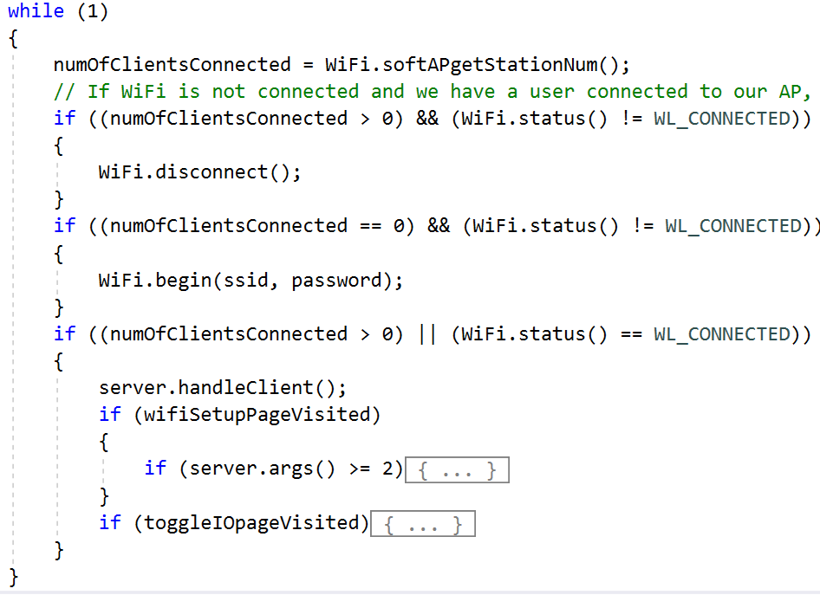
Webserver – processing incoming data

Slide 20
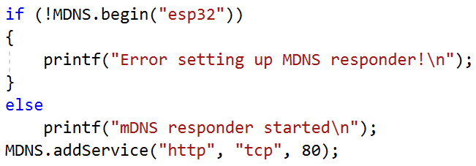
Multicast DNS
Domain Name System
MDNS – Is a zero-configuration service
Enables usage of names instead of IP address
Our ESP32 runs Multicast DNS (MDNS)
Windows and Apple devices can work with MDNS
Sadly Android does not ☹
Usage:
  http://esp32.local/
  No MDNS support - http://192.168.14.1/ (just an example IP)

Slide 21
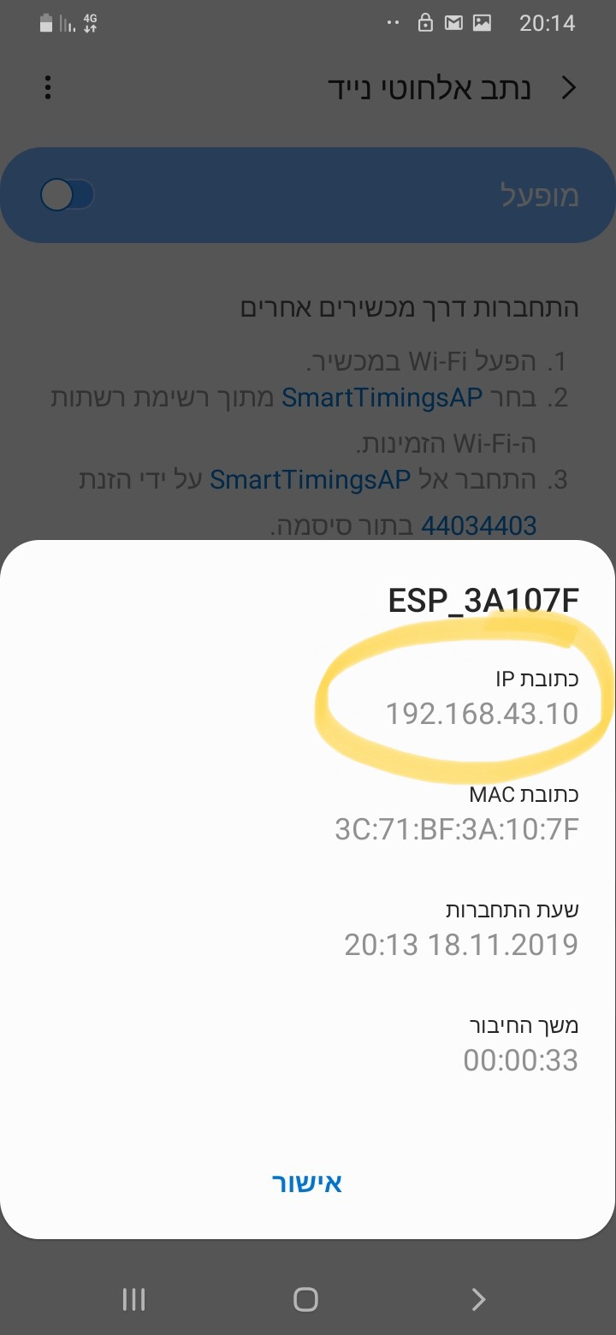
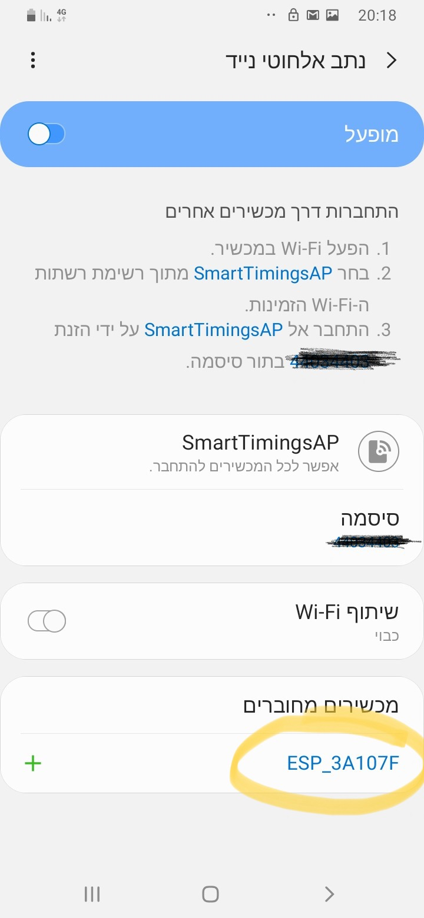
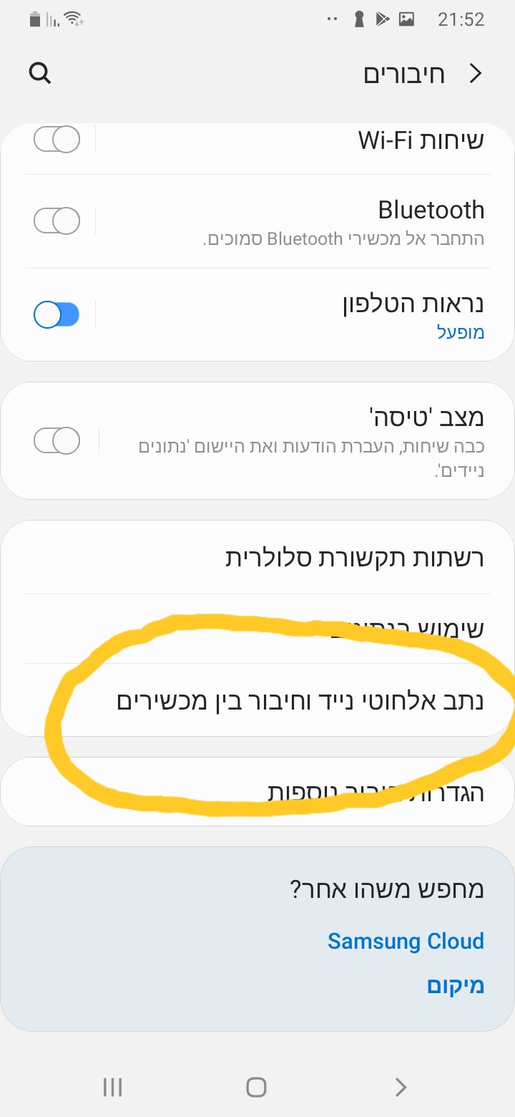
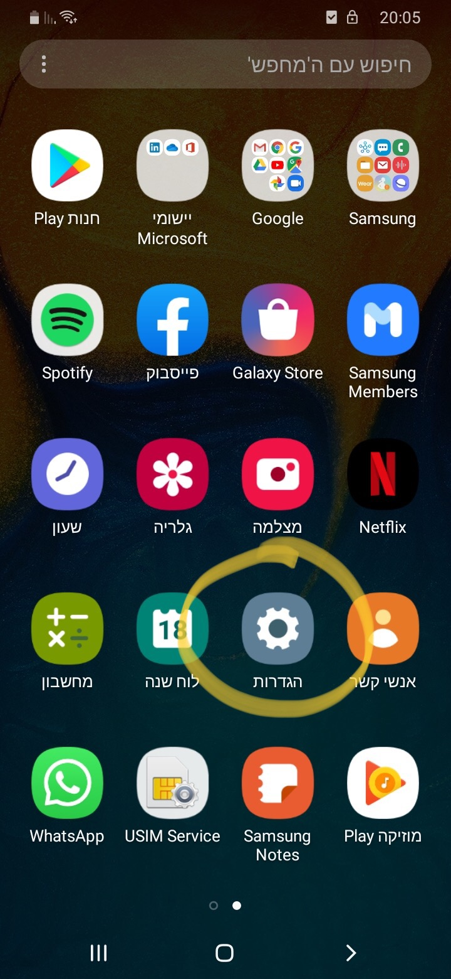
No mdns on Android so… (buy an iPhone ☺ or)

Slide 22

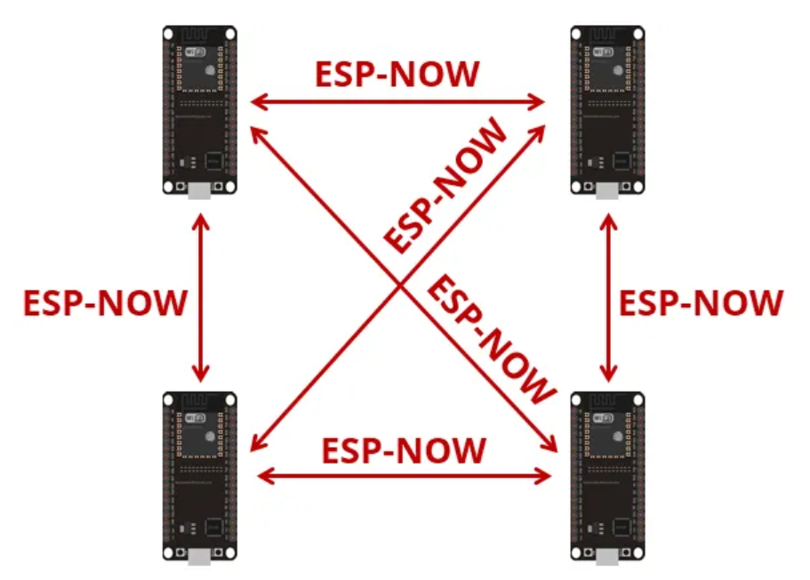
Protocol developed by Espressif
Enables multiple devices to communicate without using Wi-Fi
Low-power 2.4GHz wireless connectivity
Encrypted and unencrypted unicast communication
Up to 250-byte payload can be carried
10 encrypted peers at the most (STA mode), 6 for SoftAP or STA + SoftAP

Slide 23

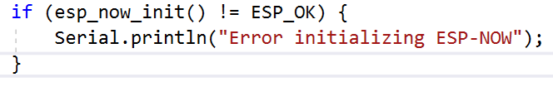
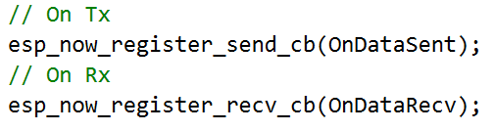

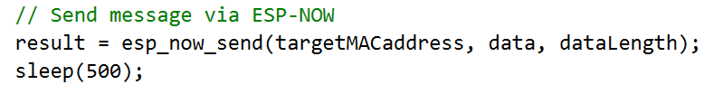
Esp-now
Works with MAC address
Need to know the our MAC and the Peer’s
Initialize the protocol
Register callback functions for send and receive
Register peers
Upon sending the send function will be called:
  With status
  With the MAC of the targeted peer
Upon receiving the receive function will be called:
  With the MAC of the sender
  With the received data

Slide 24
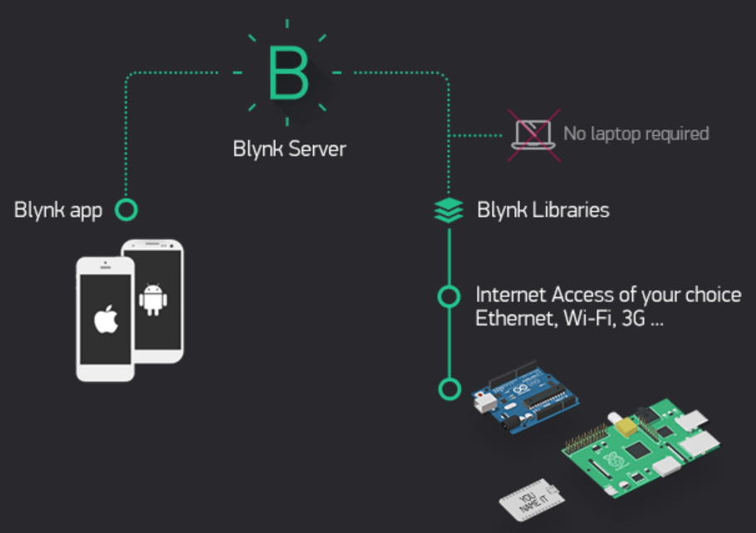
IOT – Controlling our ESP32 over the cloud
Using the ESP’s WIFI
We need to connect to a hotspot with internet access
We need a service provider to enable via cloud activities such as
  Control I/Os
  Get and push data to our ESP
There are many cloud service providers out there
I prefer using Blynk (more on the next slide ☺)

Slide 25

IOT – BLYNK
Works via application on a phone or tablet (No web or PC apps)
Can work via Wi-Fi or Bluetooth
The application is very easy to use and very powerful
Code is extremely simple to manipulate using a dedicated library
Has a code wizard generator on their website
Wi-Fi and Bluetooth code is the same, only small change in initialization
Automatic application sync for all used devices
Android supports widgets
We can use our own server!! (RPI4)
Blynk have a service to generate an application for us to be published on app store
Look at the course GIT for a user guide and a demo code

Slide 26
FW update to our IOT device
IOT device without OTA (Over The Air Update) is probably not and IOT device ☺
We have few options to update the software of our ESP32
  Automatically Over The Air where the new FW is placed on our GIT account!
  Through WEB page running on ESP32’s WEB server
  From a file residing on a SD card

Slide 27
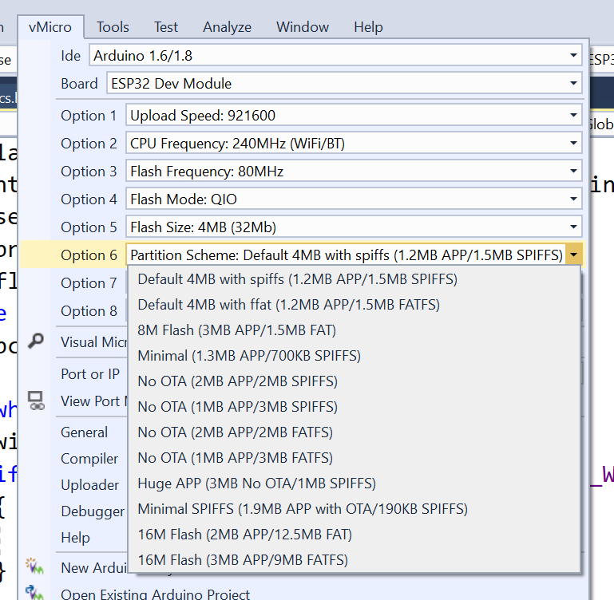
ESP32’s Partition table
To enable safe OTA an IOT device must have two SW partitions on its flash memory
ESP32 gives us the flexibility to control it’s partition table

